Slide 1
CST-104
Object Oriented
Programming In C++
Fourth Edition
Robert Lafore

Slide 2
Chapter 6 – Objects and Classes

Slide 3
Programming Paradigms
Imperative Programming
Procedural Programming
Structural Programming
Declarative Programming
Functional Programming
Object-Oriented Programming
Event-driven Programming
…

Slide 4
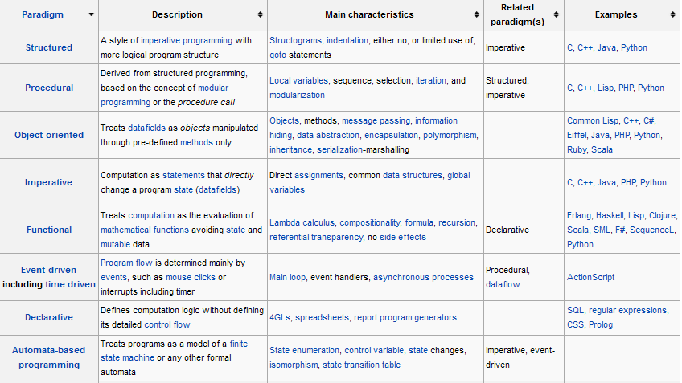
Comparisons
2
3
5
1
4
6

Slide 5
Procedural Programming
Problems in Procedural Programming
Functions have unrestricted access to global data
Unrelated functions and data provide a poor model of the real world
Unrestricted Access
Local data is hidden inside a function and is exclusively used by the function. When two or more functions of multiple functions must access the same data – the data must be made global. Global data can be accessed by any function in the program.
Real – World Modeling
Complex real-world objects have
attributes or characteristics or properties
behaviors or functions

Slide 6
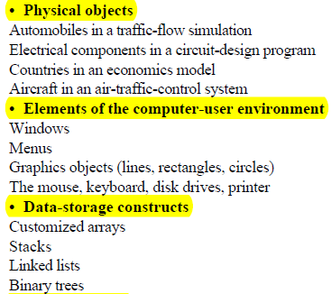
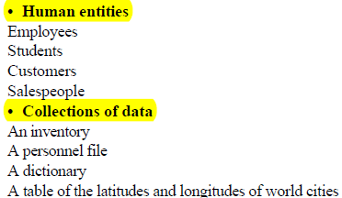
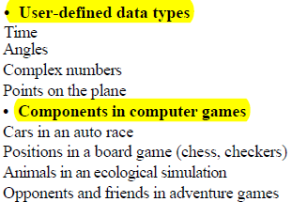
Objects in Object-Oriented Programming
What kinds of things become objects in object-oriented programs?

Slide 7
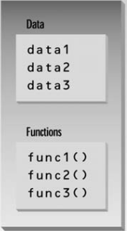
Object-Oriented Programming
Placing data and functions together into a single entity is a central idea in object-oriented programming
Features of OO language
Data Hiding
Encapsulation
Inheritance
Polymorphism ← virtual functions
Class
Notes:
Inheritance
Inheritance lets you create new classes from existing class. Any new class that you create from an existing class is called derived class; existing class is called base class. The inheritance relationship enables a derived class to inherit features from its base class.
Operator Overloading
When an existing operator, such as + or =, is given the capability to operate on a new data type, it is said to be overloaded.
Polymorphism
Using functions in different ways, depending on what they are operating on, is called polymorphism.

Slide 8
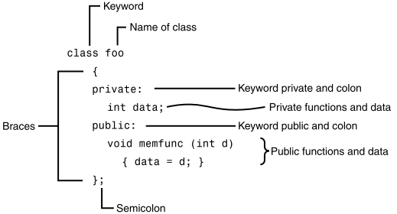
Class and Object
Defining a Class
Object : is said to be an instance of a class
Example: foo fobj;

Slide 9
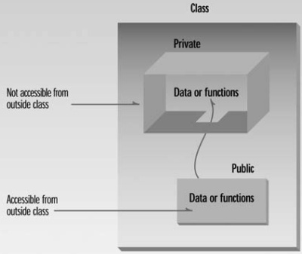
Data Hiding (or) Encapsulation
The primary mechanism for hiding data is to put it in a class and make it private.
private data or functions
can only be accessed from within the class
public data or functions
are accessible from outside the class
In C++, the default access specifier is private

Slide 10
Class - Example
class smallobj //define a class
{
private:
int somedata; //class data
public:
void setdata(int d) //member function to set data
{ somedata = d; }
void showdata() //member function to display data
{ cout << “\nData is “ << somedata; }
};

Slide 11
Accessing / Calling member functions
Defining Object
smallobj s1, s2;
Calling Member Functions
s1.setdata(10);
s2.setdata(20);
s1.showdata();
s2.showdata();

Slide 12
// smallobj.cpp
// demonstrates a small, simple object
#include <iostream.h>
class smallobj
{
private:
int somedata;
public:
void setdata(int d)
{ somedata = d; }
void showdata()
{ cout << “Data is “
<< somedata << endl; }
};
int main()
{
smallobj s1, s2;
s1.setdata(1066); s2.setdata(1776);
s1.showdata();
s2.showdata();
return 0;
}

Slide 13
Class C++ Objects as Physical Objects
// objpart.cpp
#include <iostream.h>
class part
{
private:
int modelnumber;
int partnumber;
float cost;
public:
void setpart(int mn, int pn, float c)
{ modelnumber = mn;
partnumber = pn;
cost = c;
}
void showpart()
{ cout << “Model “
<< modelnumber;
cout << “, part “ << partnumber;
cout << “, costs $” << cost << endl;
}
};
int main()
{
part part1;
part1.setpart(6244, 373, 217.55F);
part1.showpart();
return 0;
}

Slide 14
C++ Objects as Data Types
// englobj.cpp
#include <iostream.h>
class Distance {
private:
int feet; float inches;
public:
void setdist(int ft, float in)
{ feet = ft; inches = in; }
void getdist()
{ cout << “\nEnter feet: “;
cin >> feet;
cout << “Enter inches: “;
cin >> inches;
}
void showdist()
{ cout << feet << “\’-” << inches << ‘\”’; }
};
int main()
{
Distance dist1, dist2;
dist1.setdist(11, 6.25);
dist2.getdist();
cout << “\ndist1 = “; dist1.showdist();
cout << “\ndist2 = “; dist2.showdist();
cout << endl;
return 0;
}

Slide 15
Accessing Member Data with this
The this pointer can be used to access the member data in an object it point to
When the name of member data and argument are the same, use this-> to represent the member data
Example:
void setpart(int modelnumber , int pn, float cost) //set data
{
this->modelnumber = modelnumber ;
partnumber = pn;
this->cost = cost ;
}

Slide 16
Constructor
A constructor is a member function that is executed automatically whenever an object is created
it’s convenient if an object can initialize itself when it’s first created, without requiring a separate call to a member function
Automatic initialization is carried out using a special member function called a constructor
Same name as the class
No return type is used for constructor

Slide 17
C++ Objects as Data Types
// counter.cpp // page 228
// object represents a counter variable
#include <iostream.h>
class Counter
{ private:
unsigned int count; //count
public:
Counter() : count(0) //constructor
{ /*empty body*/ }
void inc_count() //increment count
{ count++; }
int get_count() //return count
{ return count; }
};

Slide 18
counter.cpp (Cont’d)
int main()
{
Counter c1, c2; //define and initialize
cout << “\nc1=” << c1.get_count(); //display
cout << “\nc2=” << c2.get_count();
c1.inc_count(); //increment c1
c2.inc_count(); //increment c2
c2.inc_count(); //increment c2
cout << “\nc1=” << c1.get_count(); //display again
cout << “\nc2=” << c2.get_count();
cout << endl;
return 0;
}

Slide 19
Initializer List
the constructor must initialize the count member to 0 in function body
Counter()
{
count = 0;
}
the preferred approach //default constructor(no argument constructor)
Counter() : count(0)
{}
If multiple members must be initialized, they’re separated by commas
Counter() : count(0), num1(10), num2(20)
{} //initializer list(member-initialization list)

Slide 20
Overloaded Constructors
//constructor (no args)
Distance() : feet(0), inches(0.0)
{ }
//constructor (two args)
Distance(int ft, float in) : feet(ft), inches(in)
{ }

Slide 21
Destructor
A destructor is is called automatically when an object is destroyed
A destructor has the same name as the constructor (which is the same as the class name) but is preceded by a tilde:
class Foo
{
private:
int data;
public:
Foo() : data(0) //constructor (same name as class)
{ }
~Foo() //destructor (same name with tilde)
{ }
};

Slide 22
Objects as Function Arguments
// englcon.cpp
// constructors, adds objects using member function
#include<iostream.h>
class Distance //English Distance class
{
private:
int feet;
float inches;
public: //constructor (no args)
Distance() : feet(0), inches(0.0)
{ }
//constructor (two args)
Distance(int ft, float in) : feet(ft), inches(in)
{ }
void getdist() //get length from user
{
cout << “\nEnter feet: “; cin >> feet;
cout << “Enter inches: “; cin >> inches;
}
void showdist() //display distance
{ cout << feet << “\’-” << inches << ‘\”’; }
void add_dist( Distance, Distance ); //declaration
};

Slide 23
void Distance::add_dist(Distance d2, Distance d3)
{
inches = d2.inches + d3.inches; //add the inches
feet = 0; //(for possible carry)
if(inches >= 12.0) //if total exceeds 12.0,
{ //then decrease inches
inches -= 12.0; //by 12.0 and
feet++; //increase feet
} //by 1
feet += d2.feet + d3.feet; //add the feet
}
////////////////////////////////////////////////////////////////
int main()
{Distance dist1, dist3; //define two lengths
Distance dist2(11, 6.25); //define and initialize dist2
dist1.getdist(); //get dist1 from user
dist3.add_dist(dist1, dist2); //dist3 = dist1 + dist2
//display all lengths
cout << “\ndist1 = “; dist1.showdist();
cout << “\ndist2 = “; dist2.showdist();
cout << “\ndist3 = “; dist3.showdist();
cout << endl;
return 0;
}

Slide 24
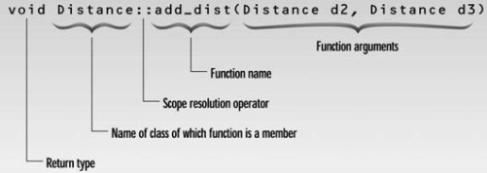
Member Functions Defined Outside the Class
The function name is preceded by the class name and a new symbol—the double colon (::). This symbol is called the scope resolution operator
void Distance::add_dist(Distance d2, Distance d3)
{
inches = d2.inches + d3.inches; //add the inches
feet = 0; //(for possible carry)
if(inches >= 12.0) //if total exceeds 12.0,
{ //then decrease inches
inches -= 12.0; feet++; //by 12.0 and increase feet by 1
}
feet += d2.feet + d3.feet; //add the feet
}

Slide 25
Returning Objects from Functions
#include<iostream.h>
class Distance
{private: int feet;
float inches;
public:
Distance():feet(0),inches(0.0)
{}
Distance(int ft,float in):feet(ft),inches(in)
{}
void getdist()
{ cout<<"\nEnter feet: ";
cin>>feet;
cout<<"\nEnter inches: ";
cin>>inches; }
void showdist()
{ cout<<feet<<"\'-"<<inches<<'\"' ; }
Distance add_dist(Distance);
};
Distance Distance::add_dist(Distance d2)
{
Distance temp;
temp.inches=inches+d2.inches;
if(temp.inches>=12.0)
{
temp.inches-=12.0;
temp.feet=1;
}
temp.feet+=feet+d2.feet;
return temp;
}

Slide 26
Returning Objects from Functions
int main()
{
Distance dist1,dist3;
Distance dist2(11,6.25);
dist1.getdist();
dist3=dist1.add_dist(dist2);
cout<<"\ndist1= ";
dist1.showdist();
cout<<"\ndist2= ";
dist2.showdist();
cout<<"\ndist3= ";
dist3.showdist();
}

Slide 27
Default Copy Constructor
Two ways to initialize objects
A no-argument constructor can initialize data members to constant values,
A multi-argument constructor can initialize data members to values passed as arguments
Another way: you can initialize it with another object of the same type. Surprisingly, you don’t need to create a special constructor for this; one is already built into all classes. It’s called the default copy constructor
It’s a one-argument constructor whose argument is an object of the same class as the constructor

Slide 28
Default Copy Constructor
class Distance
{private: int feet;
float inches;
public:
Distance():feet(0),inches(0.0)
{}
Distance(int ft,float in):feet(ft),inches(in)
{}
void getdist()
{cout<<"\nEnter feet:";
cin>>feet;
cout<<"\nEnter inches:";
cin>>inches; }
void showdist()
{cout<<feet<<"\'-"<<inches<<'\"' ; }
};
int main()
{
Distance dist1(11,6.25);
Distance dist2(dist1);
Distance dist3=dist1;
cout<<"\ndist1= ";
dist1.showdist();
cout<<"\ndist2= ";
dist2.showdist();
cout<<"\ndist3= ";
dist3.showdist();
return 0;
}

Slide 29
Uses of Static Class Data
#include<iostream.h>
class foo
{
private:
static int count;
public:
foo()
{count++;}
int getcount()
{return count;}
};
int foo::count=0;
int main()
{ foo f1,f2,f3;
cout<<"count is”<<f1.getcount()<<endl;
cout<<"count is “<<f2.getcount()<<endl;
cout<<"count is "<<f3.getcount()<<endl;
return 0;
}

Slide 30
Exercises
Page 259 – 261
Ex. 1 to 9

